Slide 1
Compiler Construction

Slide 2
Implementation of Lexical Analyzer
LEX: Lexical Analyzer Generator
We can:
Write the lexical analyzer in assembly language (most efficient, but most difficult to implement)
Write the lexical analyzer using C-like language (efficient, difficult to implement)
Use tools (Lex / Flex / Jlex) (easy to implement, but not as efficient as the first two cases)
Notes:
Flex is an advanced version of LEX. Jlex creates a program in Java.

Slide 3
LEX: Lexical Analyzer Generator (contd.)
There is a wide range of tools for construction of lexical analyzers. Majority of these tools are based on Regular Expressions.
One of the traditional tools of that kind is LEX.
Lex is a popular scanner (lexical analyzer) generator (widely used on Unix)
Developed by M.E. Lesk at AT&T Bell Labs
Other versions of Lex exist, most notably Flex (for Fast Lex)
Input to Lex is called Lex specification or Lex program
Lex generates a scanner module in C from a Lex specification file
Scanner module can be compiled and linked with other C modules
Notes:
Lex/Flex are based on the concept that for a given regular expression we can always create a DFA

Slide 4
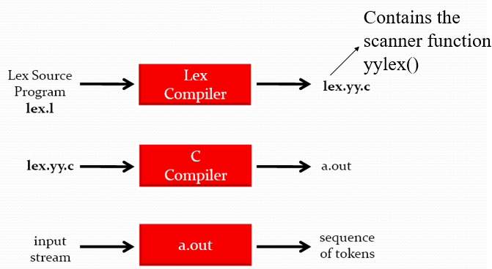
LEX: Lexical Analyzer Generator (contd.)
Input to the generator:
- List of RE’s in priority order
- Associated actions for each RE
Output of the generator:
- Program that reads input characters and breaks that into tokens.
- Report lexical errors if any
Notes:
Specify the valid tokens of a given language in terms of Regular Expression. Create a NFA from the RE. Covert the NFA to DFA
lex.yy.c is nothing but a finite automata implementation in a C program.

Slide 5
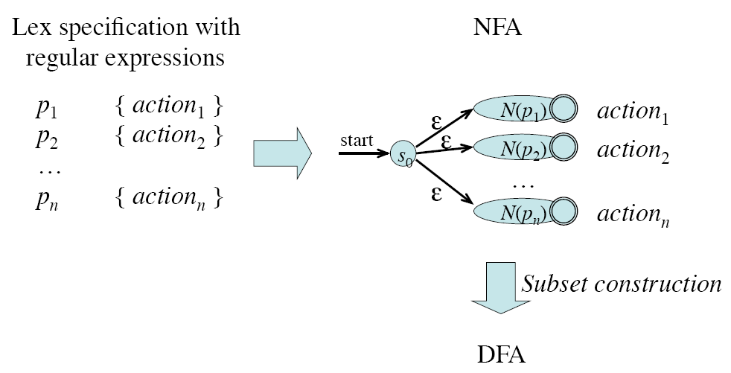
Design of a Lexical Analyzer Generator: RE to NFA to DFA
LEX: Lexical Analyzer Generator (contd.)
Notes:
How does LEX work:
RE’s describe the languages that can be recognized by FA
Translate each token RE into a NFA
Convert the NFA into an equivalent DFA
Minimize the DFA to reduce the number of states.

Slide 6

Structure of a Lex program
LEX: Lexical Analyzer Generator (contd.)
A Lex program consists of three parts:

Slide 7
Lex Specification- Declarations
LEX: Lexical Analyzer Generator (contd.)
Declaration section contains a literal block and Regular definitions.
The literal block in C code is delimited by %{ and %}
Contains variable declaration and function prototypes.
%{
< C global variables, prototypes, comments >
%}
A regular definition gives a name to a regular expression.
A regular definition has the form: name expression
A regular definition can be used by writing its name is braces: {name}
This part will be embedded into lex.yy.c

Slide 8
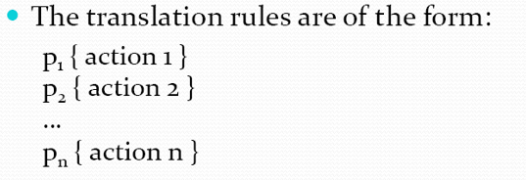
Lex Specification- Translation Rules
LEX: Lexical Analyzer Generator (contd.)
P_{i} is a Regular expression and action_{i} is C code fragment
When P_{i} matches an input string, action_{i} is executed
action_{i} should be in { }
For example:
%%
[A-Za-z]* { printf(“this is a word”); }
%%

Slide 9
Lex Specification- Auxiliary functions
LEX: Lexical Analyzer Generator (contd.)
The third section holds whatever additional functions are used in the actions.
Any user code. For example, a main function to call the scanning function yylex().
yylex( )
The default main( ) contains a call of yylex()
The output of Lex is a C file lex.yy.c with the function yylex(). This function, when called, returns a token.
The matched text is saved in yytext, and its length is yyleng
yylval contains associated value of current token
yywrap( )
is called whenever Lex reaches an end-of-file
The default yywarp() always returns 1

Slide 10
Some Relative Basic Concepts
LEX: Lexical Analyzer Generator (contd.)
A regular expression r
may contain special characters called meta-characters (do not match themselves) or meta-symbols
An escape character can be used to turn off the special meaning of a meta-character.
Such as backslash and quotes

Slide 11
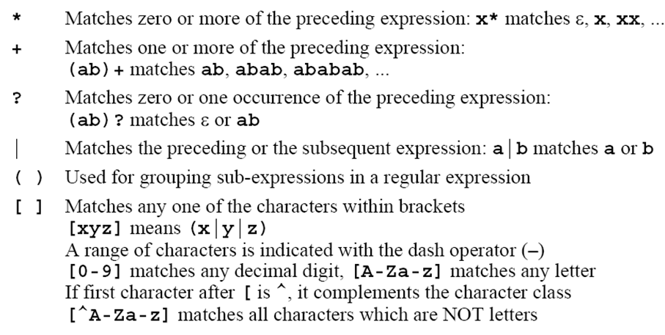
Lex Operators (Meta-characters)
LEX: Lexical Analyzer Generator (contd.)

Slide 12
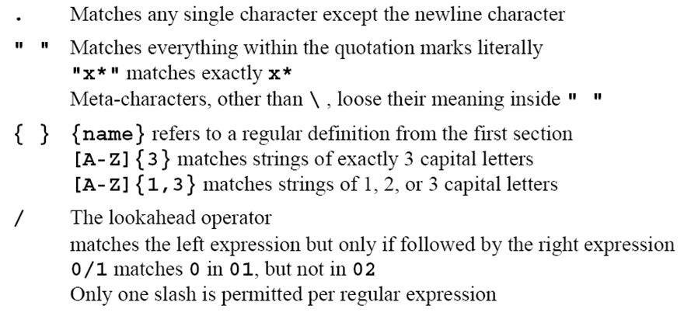
Lex Operators (Meta-characters)
LEX: Lexical Analyzer Generator (contd.)

Slide 13
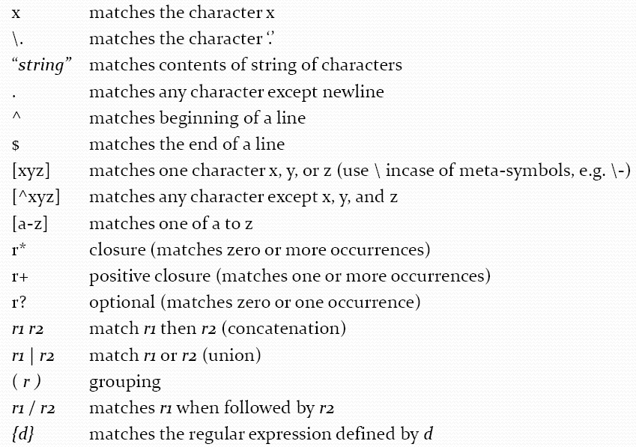
Regular Expressions in LEX
LEX: Lexical Analyzer Generator (contd.)

Slide 14
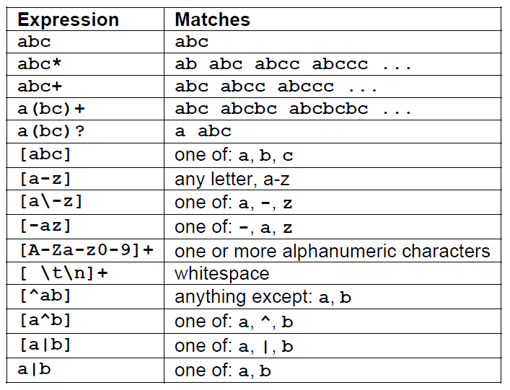
LEX: Lexical Analyzer Generator (contd.)
Lex – Pattern Matching Examples

Slide 15
Rule Priority:
LEX: Lexical Analyzer Generator (contd.)
If a given input string matches with the pattern for tokens keyword and Identifier, then the keyword has the highest priority.

Slide 16
Lex Source Program
LEX: Lexical Analyzer Generator (contd.)
Lex source is a table of
regular expressions and
corresponding program fragments
digit [0-9]
letter [a-zA-Z]
%%
{letter}({letter}|{digit})* printf(“%s is an id\n”, yytext);
.* printf(“not an identifier”);
%%
main()
{
yylex();
}

